Slide 1
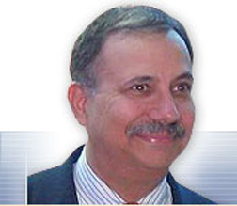


An Overview of Strategically-Focused Retailing: Opportunities and Challenges
Joel R. Evans, Ph.D., RMI Distinguished Professor of Business
Zarb School of Business, Hofstra University
Hempstead, NY, USA
joel.r.evans@hofstra.edu

